Slide 1



QINUO
ELECTRONICS CO.,LTD
Leading China's automotive electronics industry,
Make the world wireless remote control brand.

Slide 2





CONTENTS
Company profile
R & D team
production system
Product introduction

Slide 3



Company Profile
ODM/OEM
R & D, manufacturing, sales and service in one, providing professional OEM / ODM solutions.
2 independent brands
Excellent control is a famous brand in China's remote control industry, focusing on the R & D and production of copying remote control, automobile remote control, copying instrument, door opener and other garage door series products; norhang is the innovative brand focused on the development of Chino, focusing on the R & D and production of various automobile electronic control modules.
3 main products
Three main products of remote control, door opener and automobile electronic accessories.
Deep tillage for 10 years
QINUO ELECTRONICS Co., Ltd is a leading manufacturer of automatic door systems in China, offering sensors for various automatic doors and barriers, gate control board, RF remote control etc. Now we have two brands for remote control series(Ucontrol) and car auto parts(Roland).
Founded in 2009 and cultivated for ten years, it has become a well-known enterprise in the industry, with standardized dust-free clean workshop, equipped with high-speed mounter, welding robot, automatic screw machine and other automatic equipment.

Slide 4












Cooperative Partner

Slide 5

Organization
General Manager
HR
Finance
Purchasing
Sales
Administration
R&D
PM
Production
QC
Domestic Sales
Quanzhou R&D
Production
Warehouse
Oversea Sales
Wuhan R&D
Engineering
PC
Autoparts Sales
96 production staffs, 87 office staffs
Notes:
this is our organization chart, it is not so complicated. but simple and effient. we got 86 workers in production department. 55 staffs in office. the organization makes the communication more easily and high-effiency. expect some basic department, we also got the PM, who is charged in managing the product project.

Slide 6





Management System
SAP
SAP system runs through all departments of the company
MES
Import MES system to run through all links of production
GRM
Professional CRM customer management system
OA
Efficient paperless OA office system

Slide 7

Market Distribution
38%
Europe
25%
North America
27%
Asia
1%
Africa
2%
Australia
7%
South America
The market is distributed around the world, mainly in Europe, Asia and North America, and maintains long-term friendly cooperation with customers.

Slide 8

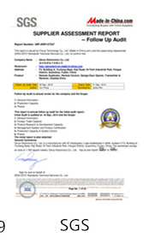
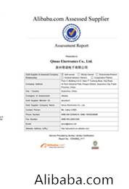


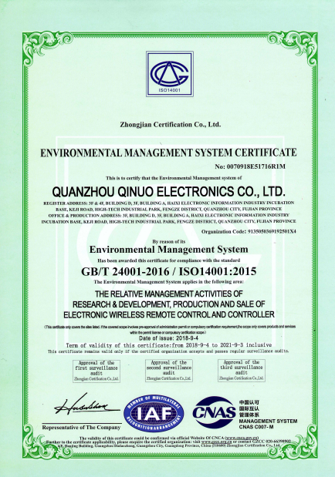
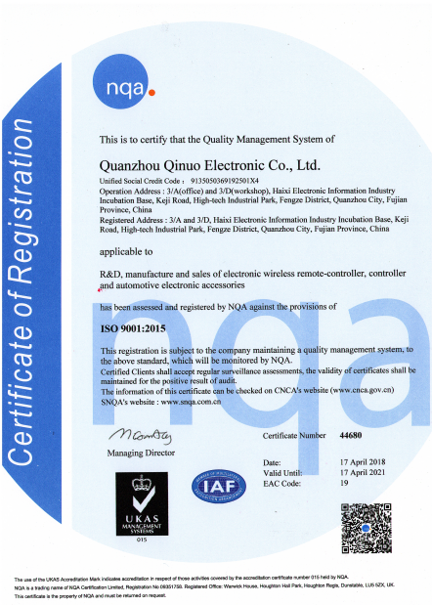
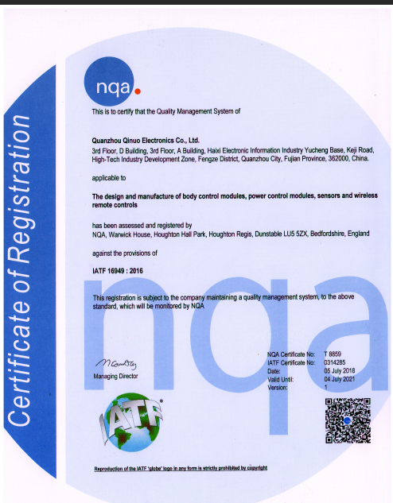

Certificate Of Honor
5Star
supplier
11year
Annual gold supplier
11year
Annual gold member
All products can meet CE, FCC, ROHS certification; meanwhile, they have obtained iso9001:2015 quality management system certification, iso14001:2015 environmental management system certification, iatf16949:2016 quality management system certification.

Slide 9



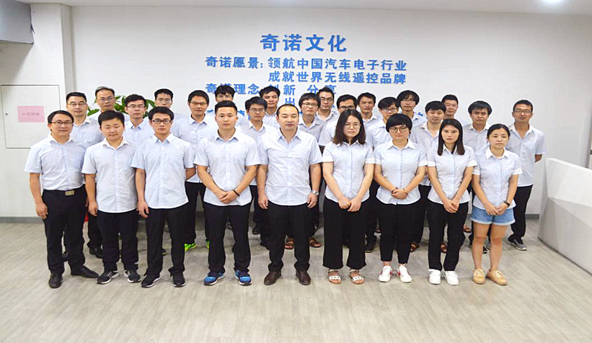
R & D Team
2
28
12
There are 36 engineers in two R & D departments, including 25 software engineers, 6 hardware engineers, 3 structural engineers and 2 assistant engineers, who are good at forwarding and reversing development.
Engineers have more than ten years of development experience at most!
2 R & D departments
28 software engineers
12 hardware engineers

Slide 10

What Can We Do？
1.Provide customized solutions, technological service and consultant service.
2.Write software by ourselves to avoid infringement problems.
3.Keep promising and improving product performance and quality.
4.Complete and strict testing before bulk purchase and mass production.

Slide 11






Preferred Supplier
All raw materials are from brand suppliers.
Before buying new materials in batches, engineers will carry out strict tests.

Slide 12
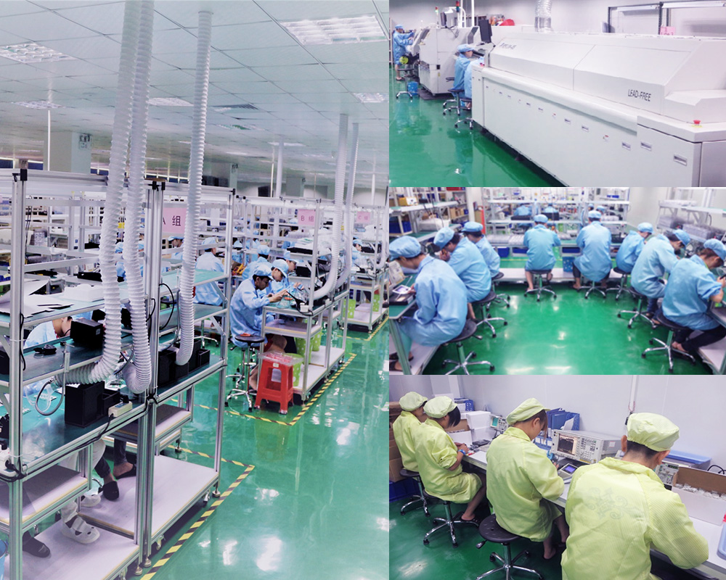
Production System
5133m²
Standardized dust free workshop
IPQC personnel monitor the whole production process
Automation
Production equipment
Use SAP system to manage every order efficiently and scientifically.
U production line
improve work efficiency
Streamline production line can ensure that each process is carried out efficiently.

Slide 13

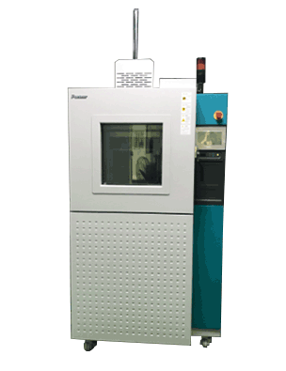
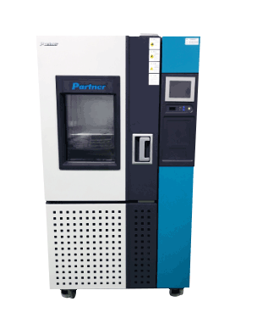
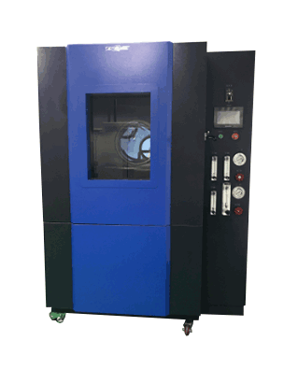
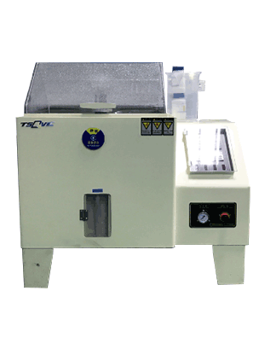
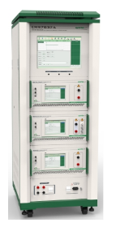
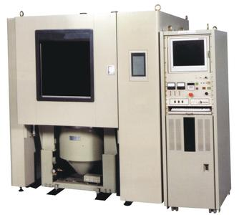
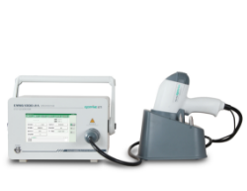
Reliability Test Equipment
High and low temperature box
Cold and hot shock box
Rain box
Salt fog box
ISO7637
Three integrated container
Electrostatic apparatus

Slide 14
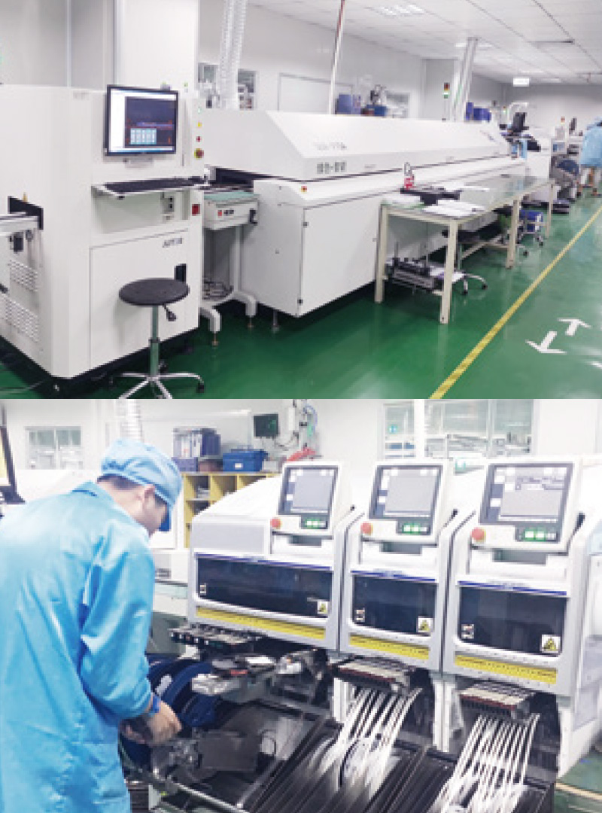
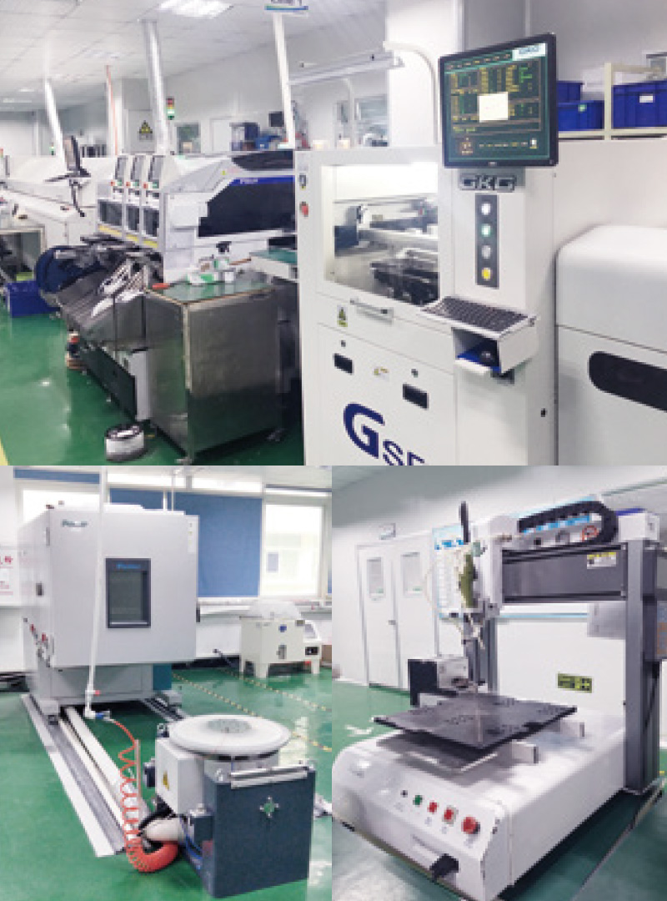
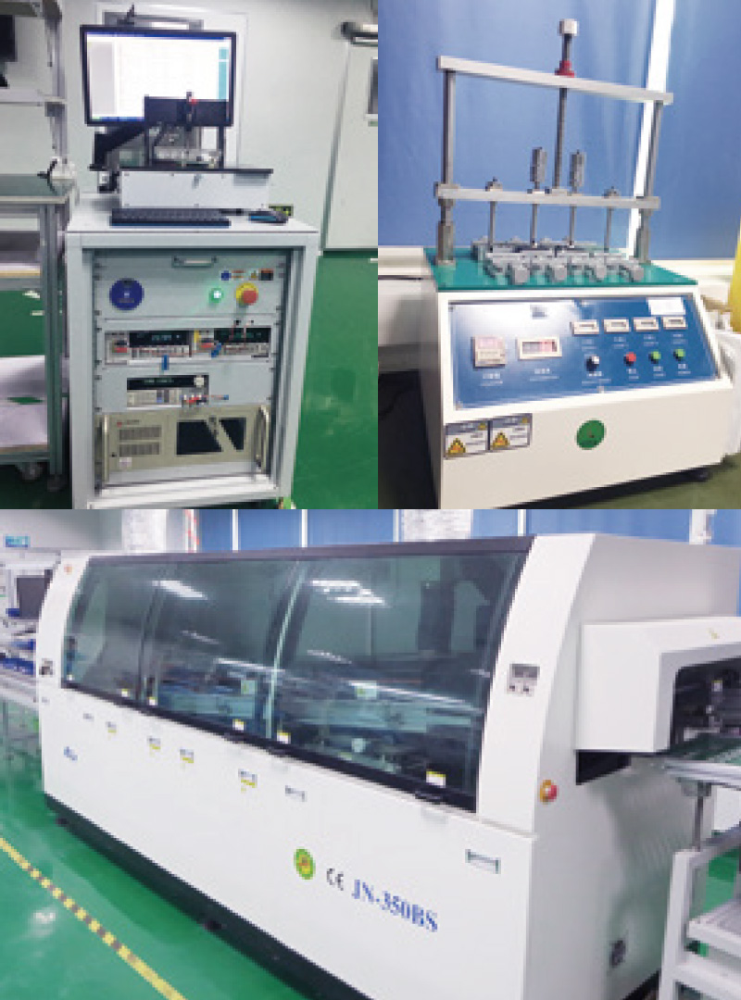
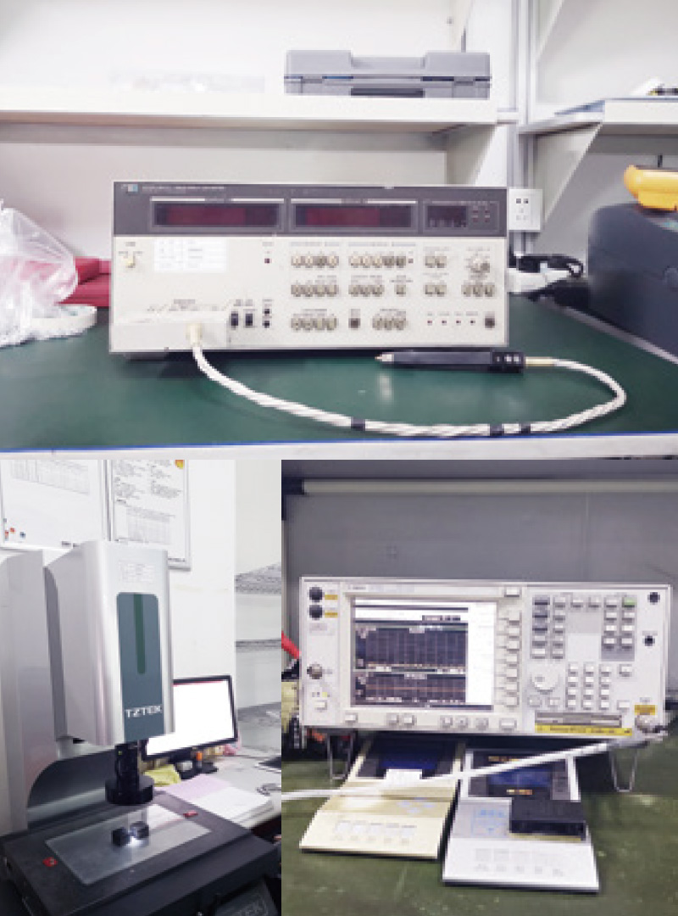
Printing machine + SMT Mounter
Automatic solder paste printing machine
Automatic learning tester
Key aging
test
LCR
Reflow + AOI
Three integrated container
Automatic screw locking machine
Wave soldering
Measuring instrument
Oscilloscope

Slide 15
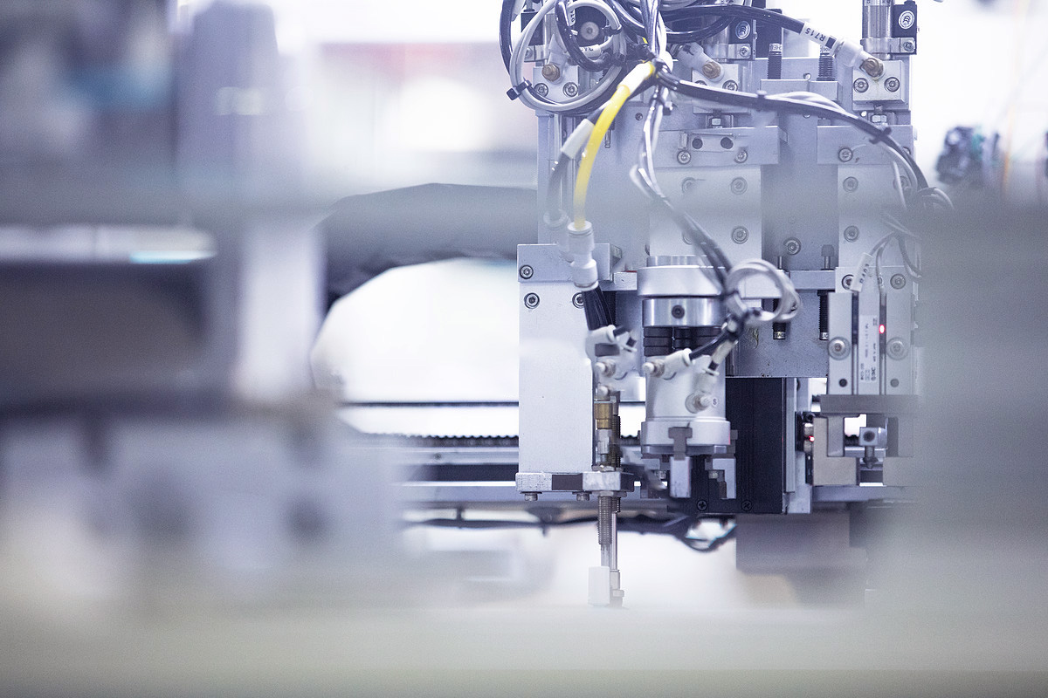
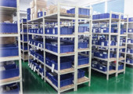

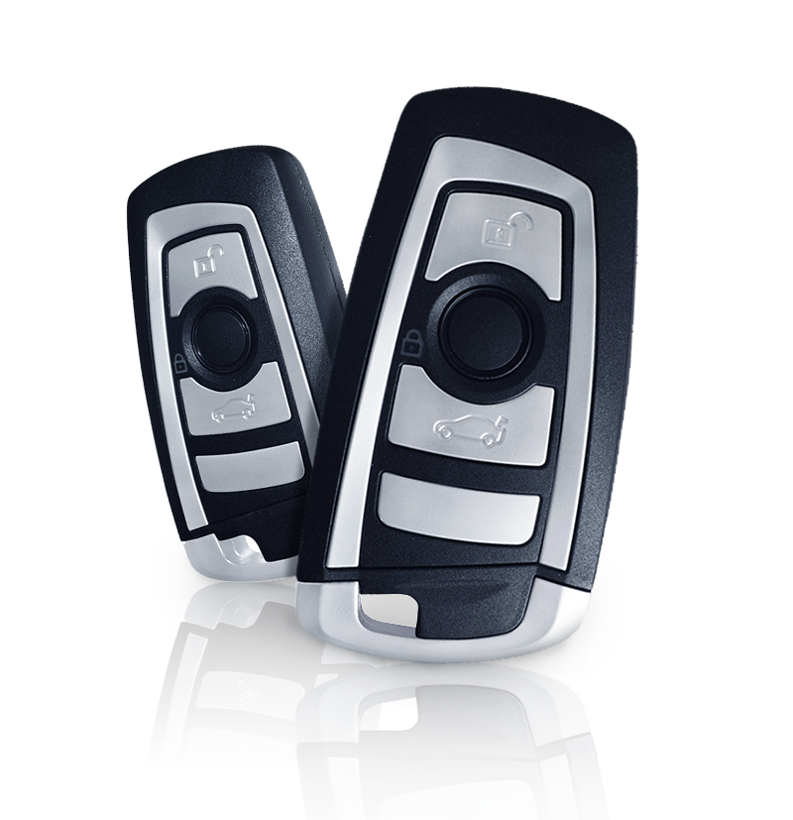
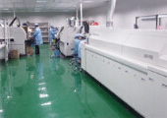
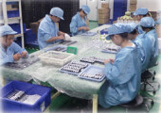
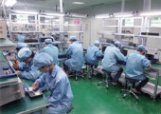
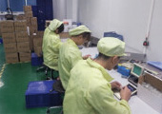
Production Process
4. Assembly (test before assembly)
1. Raw material
2. SMT machine (board detection)
5. Product packaging
6. Warehousing of finished products (inspection before warehousing)
3. Welding (welding plate detection)

Slide 16
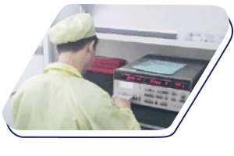
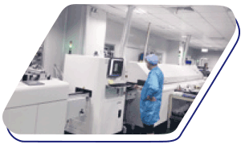
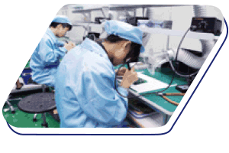
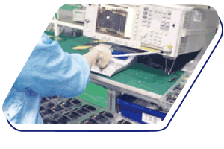
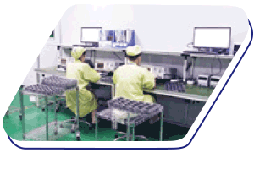
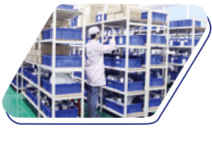
2.SMT
4.welding
6.IPQC
8.Finished
product test
10.Finished product testing
1.IQC
3.IPQC
5.Programmed learning
Quiescent current test
7.Assemble
9.Packing
Quality Management
From the incoming materials, production process, finished product inspection, to the final delivery inspection, the whole process is in accordance with the standards of the product technical parameters specification;
The quality inspection meeting will regularly review the suppliers of raw materials to ensure the stability and quality of raw materials.
MES system runs through the whole production process.

Slide 17

Production work order release
Material in / out
Product offline
product storage
Production process
Product line
Remarks：
Production work order receiving
PCBA
Assemble
Packing
Warehousing
Production tracking
SMT patch
First step assembly
Packing
Warehouse receipt
Use of raw materials
SMT single side
Spray paint
QINUO
MES system
Production work order distribution
SMT double sided
Second step assembly
Material combination (semi-finished product)
QC detection
Wave soldering
Glue
pouring
Labor cost
welding
HLA test
Repair
Process detection
QA
detection
PCB cleaning
Repair goods handling
Repair
PCBA test
Anti daze (system setting)
Production equipment
SMT Mounter
Testing equipment
Barcode printing equipment
LED large screen
LCD TV board
……
Test data integration,
linking to products

Slide 18
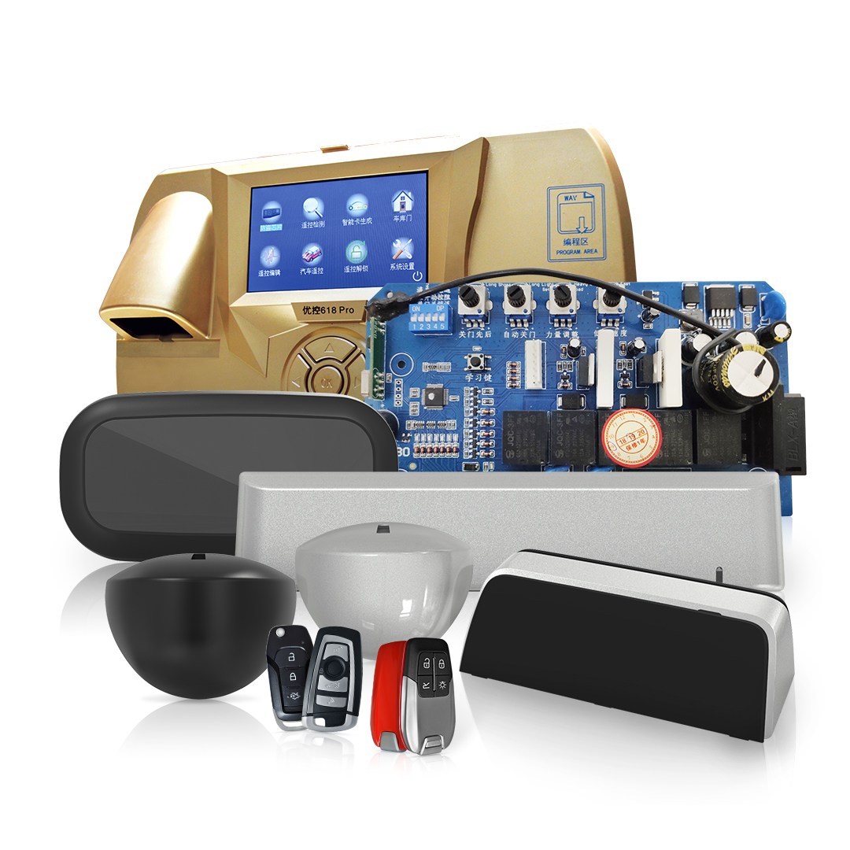
Product Introduction
Automatic door sensor
Door opener
Remote control

Slide 19
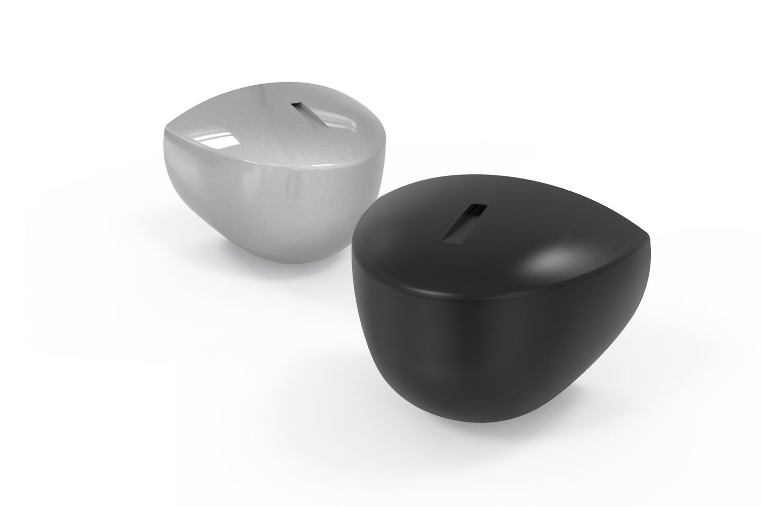
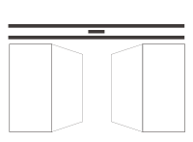
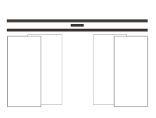

Microwave sensor
1. Microwave Doppler radar technology
2. Imported main board - Rogers
3. Adjustable magnetic field detection without complex adjustment
4.24.1250 GHz transmission frequency
5. Accept customization
6. Comply with American and European standards
Swing door
Sliding door
Revolving door

Slide 20

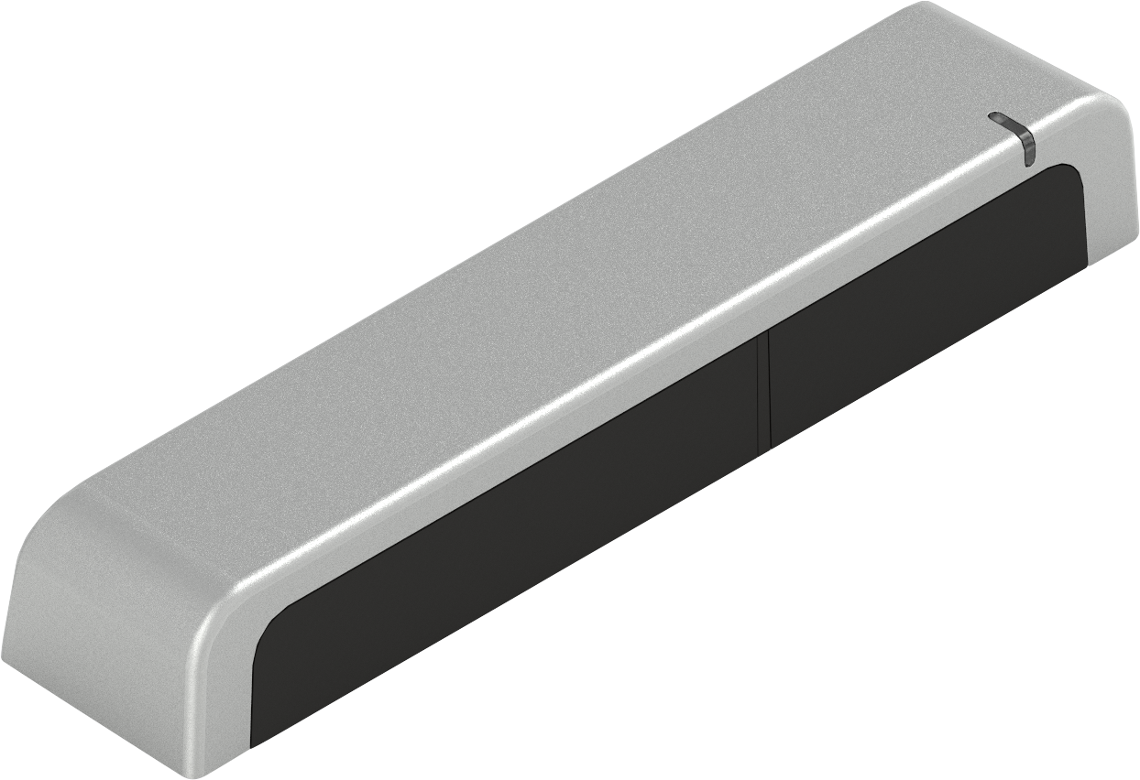
Pure Infrared Sensor
1. Microwave Doppler radar technology
2. Imported main board - Rogers
3. Adjustable magnetic field detection without complex adjustment
4.24.1250 GHz transmission frequency
5. Accept customization
6. Comply with American and European standards

Slide 21
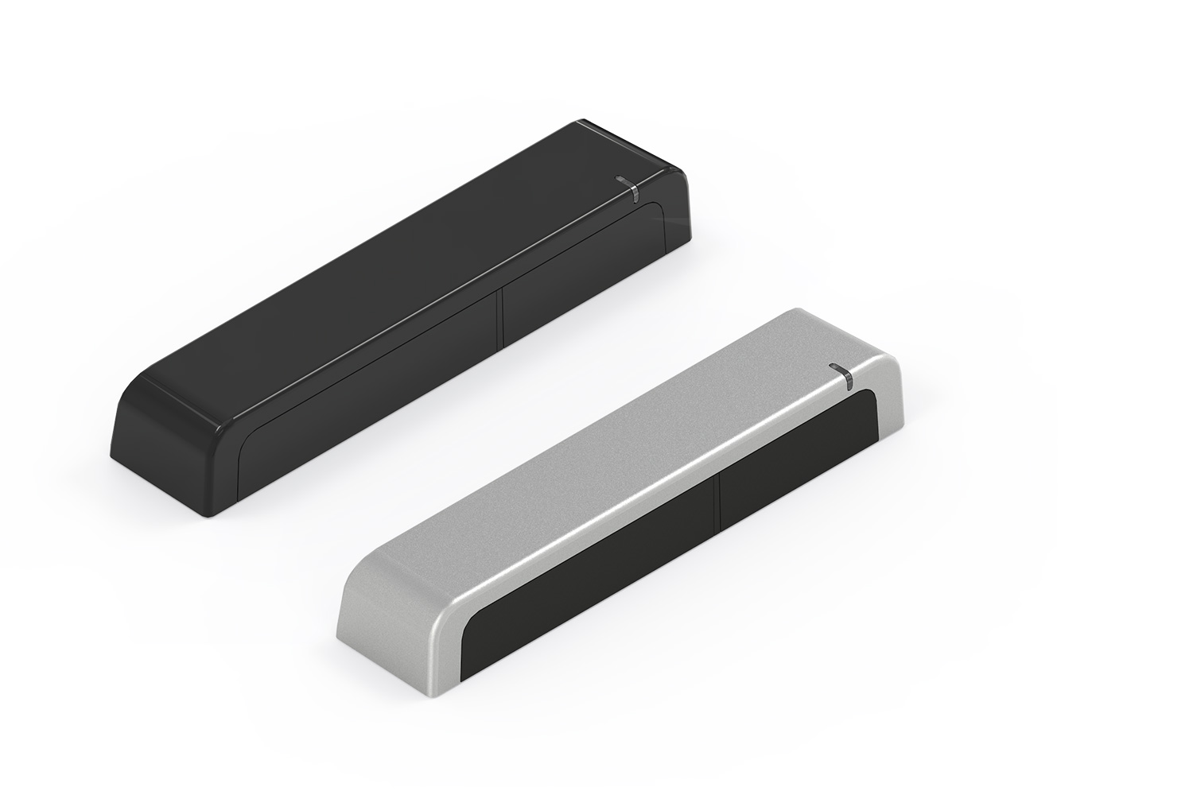
Microwave Infrared Integrated Sensor
1. Microwave Doppler radar technology
2. Imported main board - Rogers
3. Adjustable magnetic field detection without complex adjustment
4.24.1250 GHz transmission frequency
5. Accept customization
6. Comply with American and European standards
Swing door
Sliding door
Revolving door

Slide 22
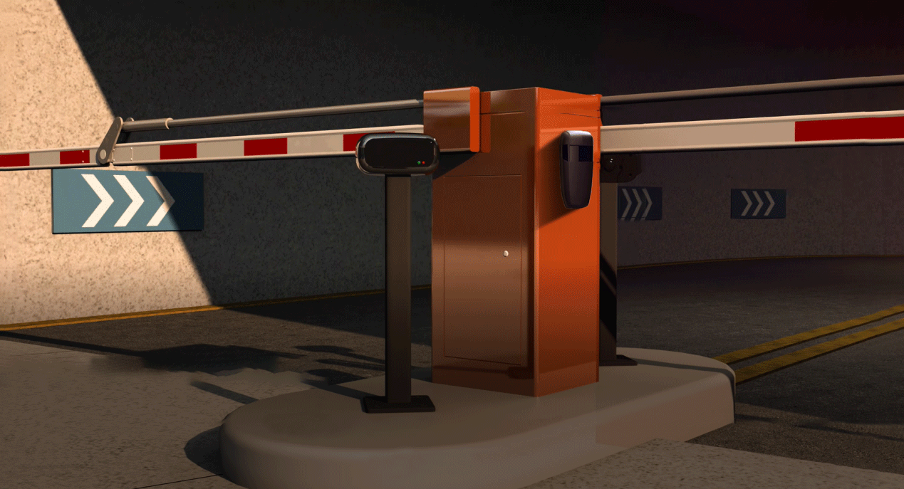
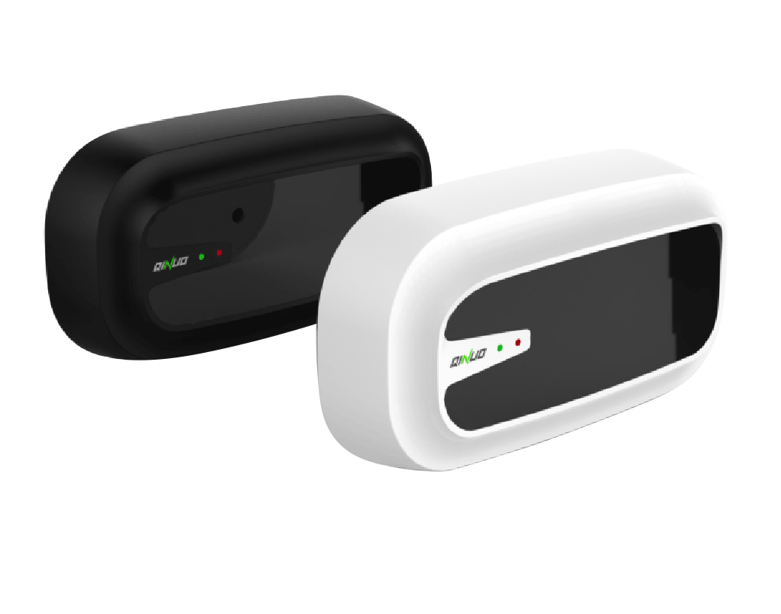
Gate Inductor
Characteristic
Convenient construction: no need to cut the road surface, small volume, easy installation and maintenance;
Convenient maintenance: in case of failure, only the probe itself needs to be replaced to ensure the normal operation of the whole system;
Classification and recognition: vehicle and per capita can be identified, with a maximum detection distance of 6m;
Long service life: 1-2 years for coil, 3-5 years for radar;
Applicable to: straight arm gate, curved arm gate, fence gate, anti-collision gate.
Notes:
these are some control boards for garage door and roller shutter. this one is a custozed product for one of our domestic customer, is used for conttrolling swing door. for control board, our aim is to provide a professional ODM/OEM solution and service to the customers.

Slide 23
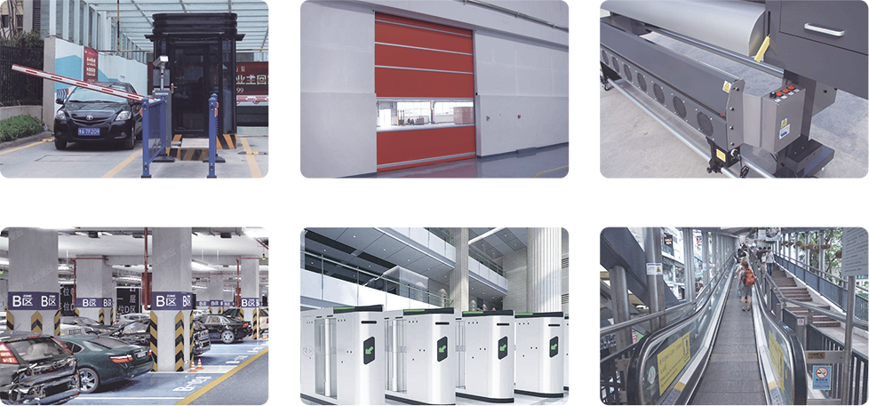
Parameter
Technology: infrared TOF
Transmission frequency: 2.4m
Installation height: 30-50cm
Detection mode: infrared reflection
Indicator light: standby green light, trigger red light
Power supply voltage: 12V ± 10%
Power frequency: 50-100hz
Consumption: < 2.5W
Maximum current: 200mA
Temperature range: - 30 ° C to + 70 ° C
Size: 186.5 (L) × 97.1 (H) × 61.3 (W) mm
Material: PMMA + ABS
Length of connecting line: 1.5m
Vehicle anti smash
Industrial automatic door
Mechanics
Parking system
Channel gate
Escalator

Slide 24
Why is the gate probe selected?
The plane beam is used for infrared counter shooting, even if a leaf is blocked, it will cause false triggering and installation is not successful It is convenient and needs to be wired.
Convenient construction, no need to cut the road surface, small volume, simple installation and maintenance, direct use of brackets for fixed installation,Less manpower, shorter construction period and lower construction cost.
In the later maintenance process, the fault probe only needs to replace the sensor itself to ensure the normal operation of the whole system, which is time-consuming and labor cost is greatly reduced. In contrast, after the coil breaks down, it needs to dig out the broken coil on the original basis, and then cut and fill again, the whole process is very complicated.
The vehicle can be identified by classification and recognition, and the maximum detection distance can be up to 6m
Reduce false triggering
The utility model has a long service life, the coil is generally used for 1-2 years, and the radar can be used for 3-5 years; in the long-term use process, the use of the gate sensor can bring obvious cost reduction to the user.
Compared with the infrared vehicle detector, the road gate radar can distinguish people and vehicles, avoid the pedestrian triggering the automatic gate lever to rise; it has strong environmental adaptability; it is easy to install, and does not need to dig slots and thread.

Slide 25
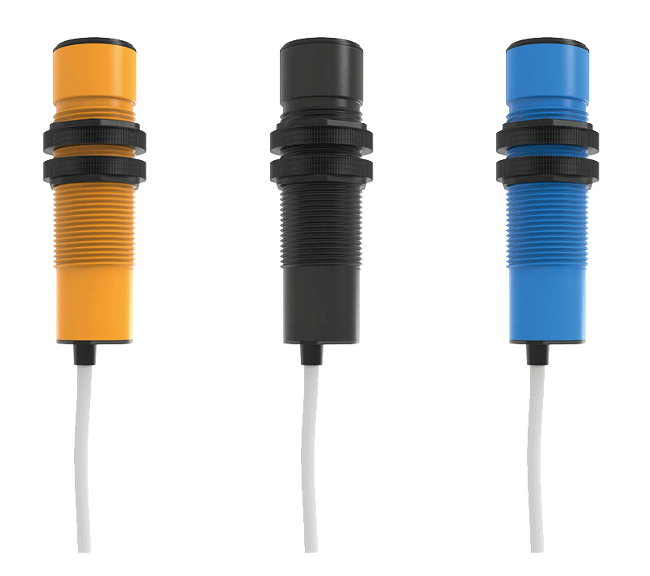
Single Line Infrared Trigger Probe
Parameter
Installation method: embedded installation
Working environment temperature: - 40 ℃ - 80 ℃
Detection distance: 0-6m
Waterproof grade: IP54
Power supply voltage: 12-24V, AC \ DC
Detection objects: static objects and moving objects
Relay output holding time: 1s
Test surface material (lens): PMMA
Detection response time: 2ms
Shell material: PMMA + ABS
Output current: 1a.max
Wire length: 1.5m
Current consumption: < 100mA
Working environment humidity: 35 ~ 95% RH
Notes:
these are some control boards for garage door and roller shutter. this one is a custozed product for one of our domestic customer, is used for conttrolling swing door. for control board, our aim is to provide a professional ODM/OEM solution and service to the customers.

Slide 26
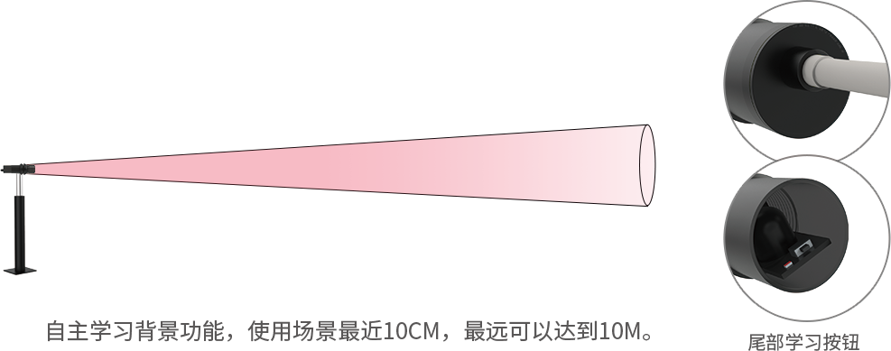
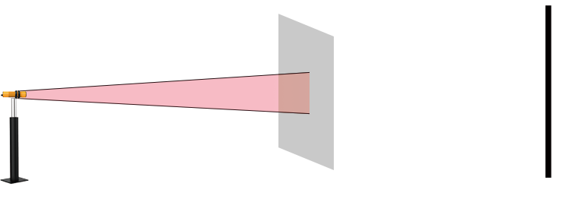
①
③
②
Working Diagram
① Self learning background function, the latest use scene is 10cm, and the farthest can reach 10m
② When there is an object nearby to block the infrared ray, the switch is open or closed
③ Tail learning button
Normally open: it is always disconnected when there is no object blocking it; When there is an object blocking, the switch is closed.
Normally closed: it is always closed when there is no object blocking it; When there is something blocking, the switch is off.
Notes:
these are some control boards for garage door and roller shutter. this one is a custozed product for one of our domestic customer, is used for conttrolling swing door. for control board, our aim is to provide a professional ODM/OEM solution and service to the customers.

Slide 27
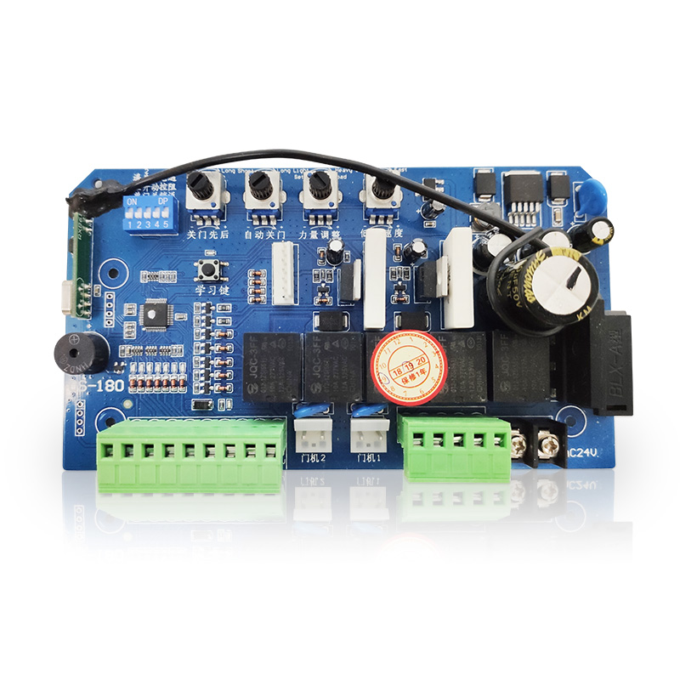
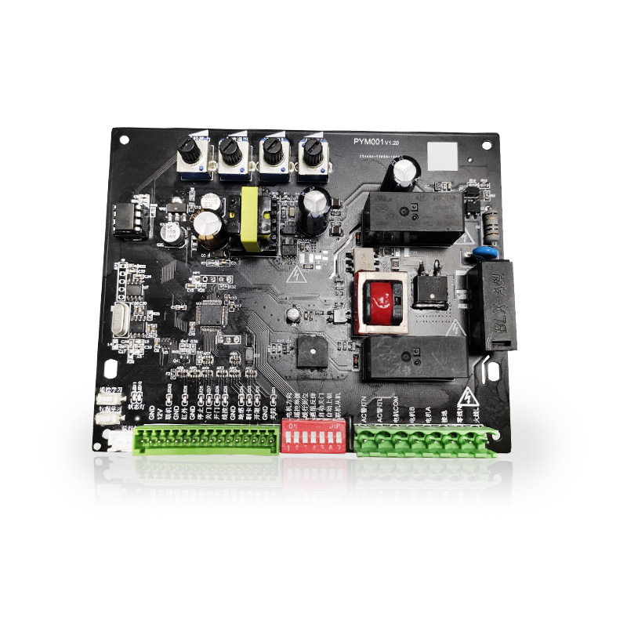
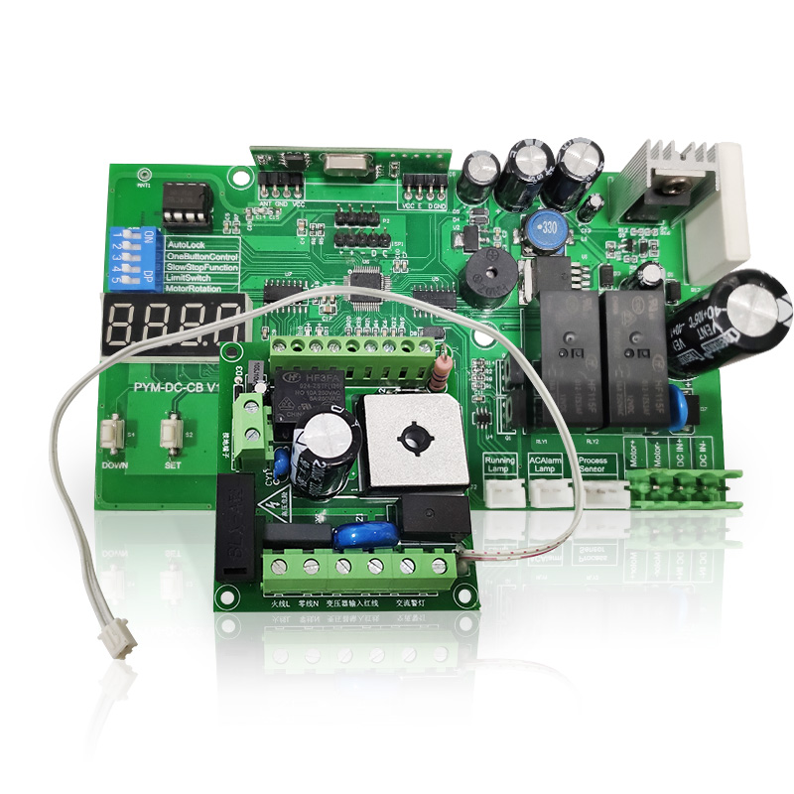
Controller
Swing door controller
Swing door controller
AC sliding door controller

Slide 28
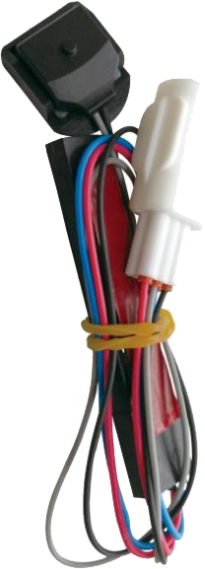
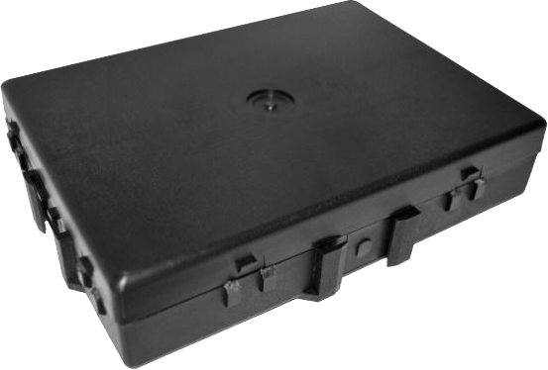
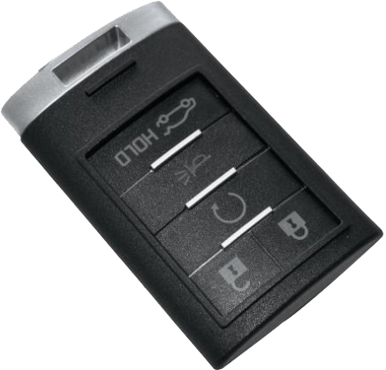
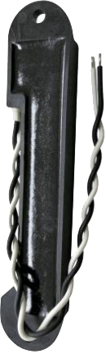

Product Development
Passive Entry Passive Start
Including: Remote Control, Controller, Immo Coil, Antenna
Notes:
we have 48 engineer in total, 28 in sofeware,12 in hardware, 6in struture, also have 2 assistants.

Slide 29




On Vehicle Calibration
*Function testing and troubles shooting base on different calibrations
*Take Air-Conditioning Panel as example：Need to collect signal and in-service state of all sensors and actuators of the vehicle
*By using simulation software and electronic testing device to emulate parameters of all sensors
Remote key low frequency Calibration Tool
Notes:
we have 48 engineer in total, 28 in sofeware,12 in hardware, 6in struture, also have 2 assistants.

Slide 30

Project Management
Project Team
Project Development Plan
Notes:
we have 48 engineer in total, 28 in sofeware,12 in hardware, 6in struture, also have 2 assistants.

Slide 31

Project Management
Notes:
we have 48 engineer in total, 28 in sofeware,12 in hardware, 6in struture, also have 2 assistants.

Slide 32

Design Validation
Notes:
we have 48 engineer in total, 28 in sofeware,12 in hardware, 6in struture, also have 2 assistants.

Slide 33

Remote control
ODM
OEM
LOGO
customization
Packaging
customization
遥控器

Slide 34



KIT control box
Notes:
these are some remote controls. at the beginning we have produce fixed code but for now we updated them from the outlook, for now we have fixed code, rolling code , and also hopping frequency plus rolling code.

Slide 35
Thank you
for watching

